Slide 1
Advanced Systems Analysis and Design Conducting Reviews SOFT 30121 L20 Presented By Nigel King ACMA CGMA PCM Nigel.King@ntu.ac.uk

Slide 2

Conducting Reviews

Slide 3
The Big Picture
Constructing your sprint plan
Defining your teams’ definition of “done”.
Conducting Scrum Meetings
Conducting Reviews

Slide 4
Conducting Reviews
2 Reviews being covered here
Sprint Reviews
Phase Reviews

Slide 5
Sprint Reviews
What is a sprint review?
Held at the end of each sprint to demonstrate the added functionality. The goal is to get feedback from the product owner and other stakeholders to ensure that the delivered increment met the business need and to revise the Product Backlog based on the feedback. This feedback will then become items that will be looped back into the Product Backlog, where it can be ordered and pulled in by the team in a future Sprint.

Slide 6
Sprint Reviews
Who should attend?
Engineers
Quality Assurance
User Interface Design
Scrum Master
Product Owner
Optional
Intersecting Product Owners
Executives
At Powerschool these were pretty well attended by senior management, because we got to set direction without having to be the product owner or product managers. We could spot inconsistencies between products.

Slide 7
Sprint Reviews
Celebrate
If you have recruited well, everyone is exited to show what they have done. People should celebrate a bit when they have showed their stuff.
Utilizing Non Code design deliverables
At Powerschool we were also keen to see things that were not yet code; storyboards, UI Schematics.
This did allow us to spot issues and redirect without having to tear down things that people have become attached to.
We did notice when teams spent a lot of time on non code issues, it was generally a symptom of a problem in the team.
At Oracle, demonstrating progress was very important, well before the world used the word Agile. However, successful managers at Oracle were very good at managing their dependencies and exposure so demos became to a more concentrated audience. We celebrated less.

Slide 8
Phase Reviews
What is a phase review
When we need to get documents through a design cycle and get consensus. This was more common in Oracle when teams may be reliant on a common service. For example, Financials, HCM and CRM may all have the notion of an organization structure. Customers buying the full suite may be less than satisfied if they find that they have to set up Department Structures in HR and Cost Center structures in Financials and Territory Structures in CRM that largely overlap.

Slide 9
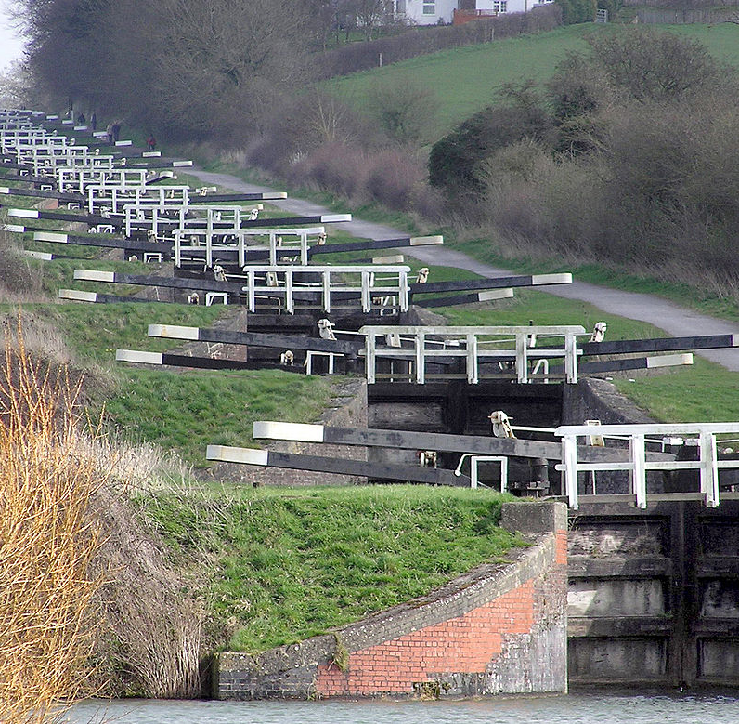
Phase Reviews
What are the phases?
Branstorming:
Proof of Life: -
Draft Complete: -
Issues Complete:
15 minutes of fame:
Document Closure:

Slide 10

Phase Reviews
What are the phases?
Brainstorming: - Get the idea kicked off and allow the stakeholders to contribute. This is really important that the people that can derail your design, recognise their contribution in the final product.

Slide 11
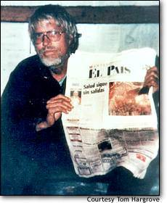
Phase Reviews
What are the phases?
Proof of Life: - Just prove to us that the document exists. (We can sometimes avoid some gross error. Good engineers never want to release designs that are less than perfect and designs are never perfect.

Slide 12
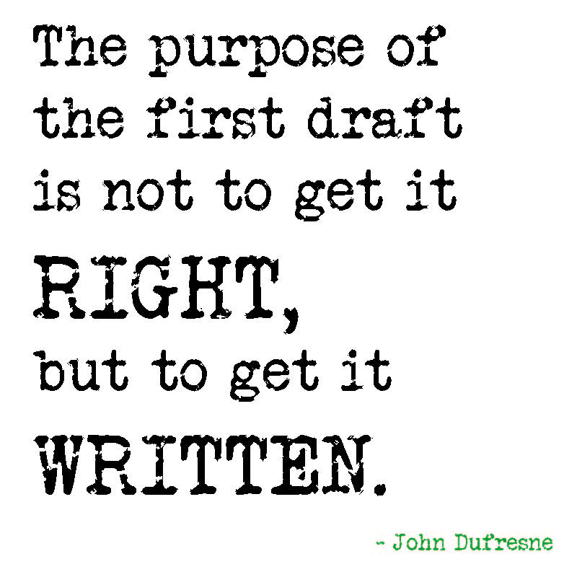
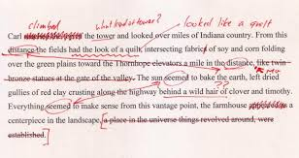
Phase Reviews
What are the phases?
Draft Complete: - You have a document that the author believes meets the objective of the document. We generally asked the author to take us through the document in a review meeting. Once reviewed we would give the stakeholders a few days to record issues in the document.

Slide 13
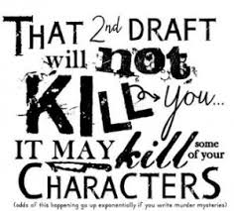
Phase Reviews
What are the phases?
Issues Complete: Once the clock has run out on recording issues, the author has to provide edits and disposition to the issues. We used to be pretty good at judging if we could close a design by the number of issues that had been recorded.

Slide 14

Phase Reviews
What are the phases?
15 minutes of fame: If we had a large constituency and were having difficulty closing issues, we would allow stakeholders a fixed time to voice their concerns and be rigorous in ensuring that they agree action plans.

Slide 15

Phase Reviews
What are the phases?
Document Closure: Final issues have dispositions. The design is at closure and we put the design under rev control.
This Photo by Unknown Author is licensed under CC BY-SA

Slide 16
Next Lecture
How to Demo.

